Slide 1
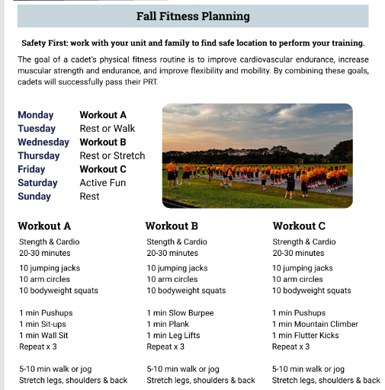
FITNESS TRAINING PLAN

Slide 2
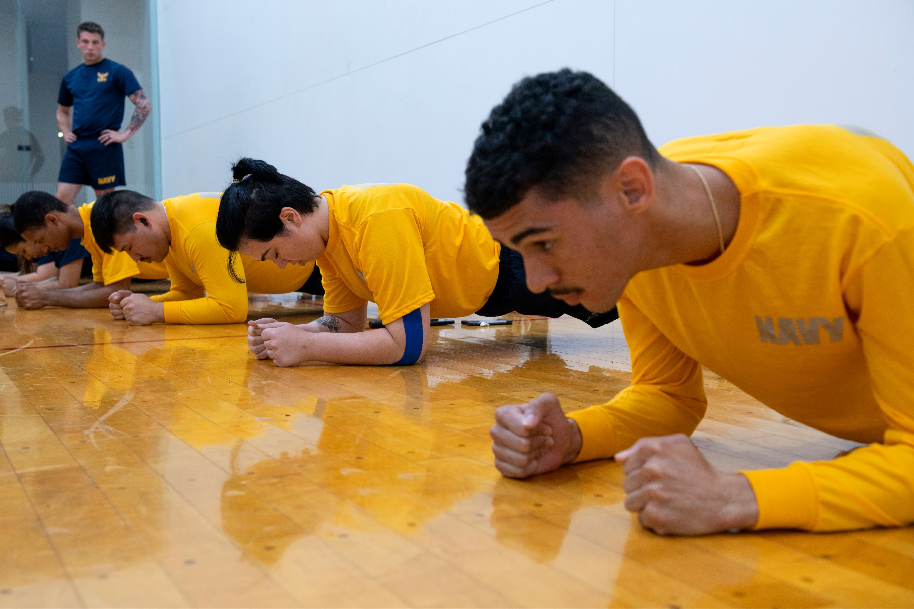
PLANK
DEMONSTRATION: https://www.youtube.com/watch?v=iPVKhj3dudA
Notes:
https://www.youtube.com/watch?v=iPVKhj3dudA

Slide 3
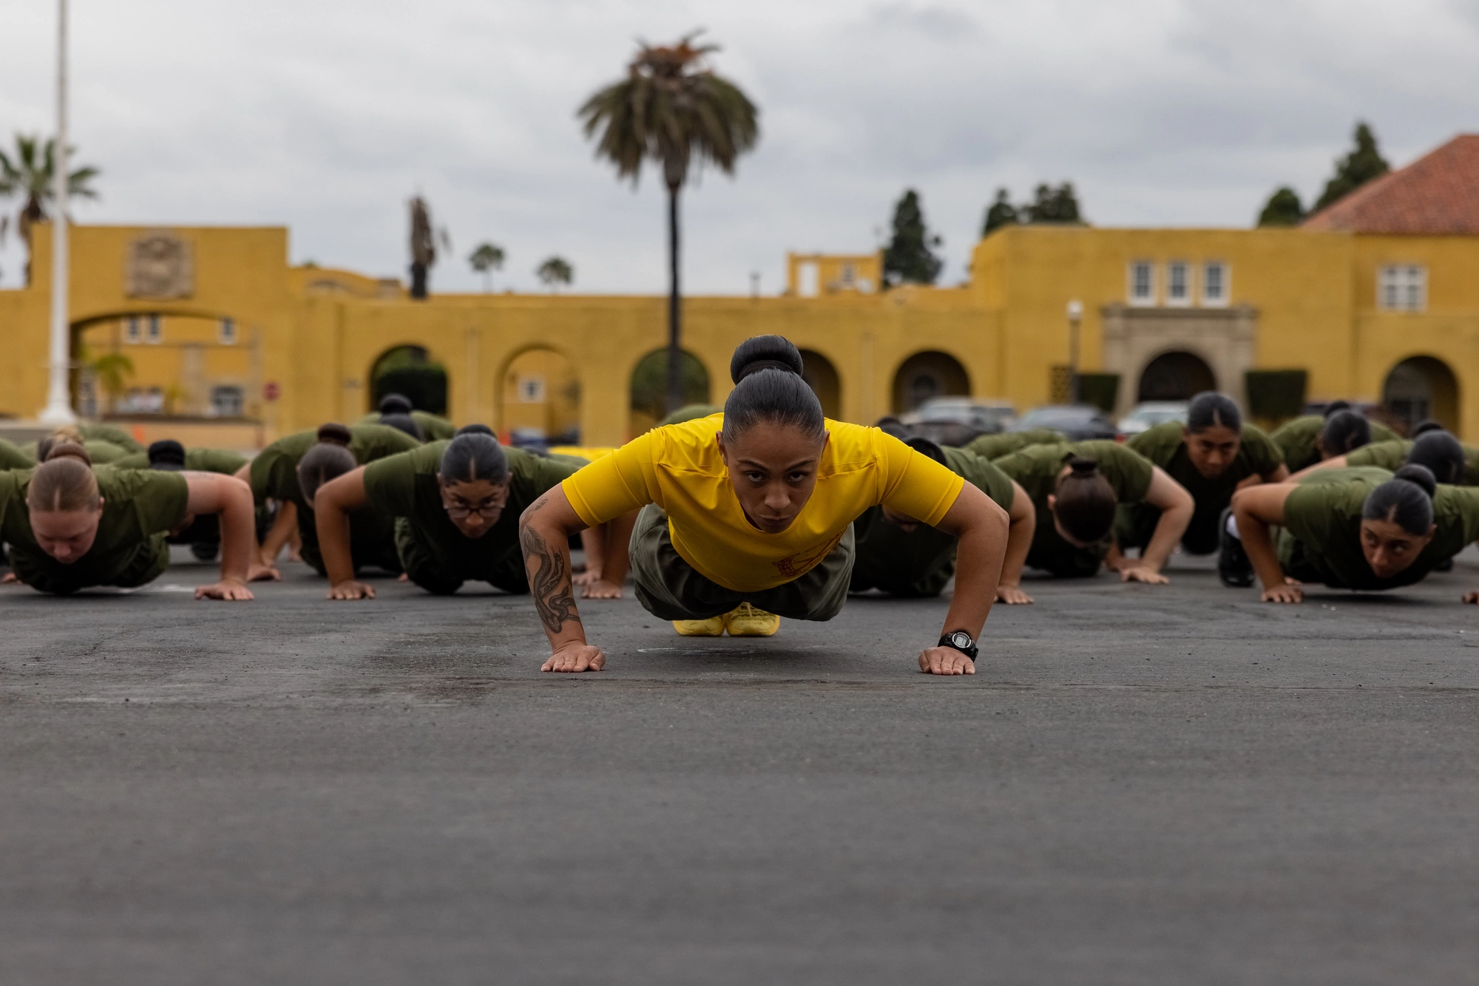
PUSH UP
DEMONSTRATION: https://www.youtube.com/watch?v=Get-JgZvI0A
Notes:
https://www.youtube.com/watch?v=Get-JgZvI0A

Slide 4
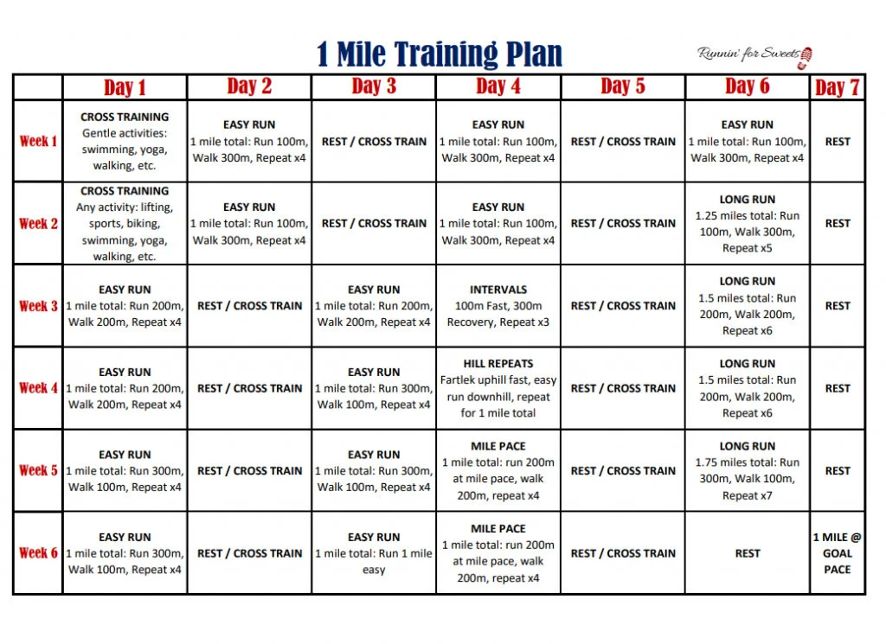
RUNNING- START NOW!

Slide 5


RRB RUNNERS!

Slide 6
Running: a well-rounded mile training plan lasts 8-12 weeks
Weekly Training Overview
A typical week in a mile training plan should include a mix of easy runs, speed intervals, hill repeats, and a long run to improve both endurance and tissue capacity. It’s important to avoid doing two intense workouts back-to-back, ensuring adequate recovery.
Monday: 30-35 minute easy run. This is about getting your legs moving and allowing your body to recover from the previous week.
Tuesday: Speed workout, such as hill repeats or interval training. For beginners, start with 6-8 hill repeats of 30 seconds, jogging downhill for recovery. More advanced runners can progress to longer intervals on flat ground, like 400-meter intervals at goal mile pace.
Wednesday: Rest or active recovery, such as walking, cycling, or light cross-training.
Thursday: 30-35 minute easy run. This is another light day to absorb Tuesday’s workout.
Friday: Fartlek workout. This involves alternating between faster and slower paces, such as 12 x 1-minute at 5K pace with 1-minute easy jogs in between. Fartleks help improve speed without the pressure of fixed intervals.
Saturday: Rest day or active recovery. Avoid back-to-back intense days to prevent overtraining.
Sunday: Long run, starting with 45-50 minutes and gradually increasing as your training progresses.
This structure allows for a balance between recovery and intensity. It also ensures that you’re developing both aerobic capacity and speed, critical components of a successful mile race.
Notes:
The Ultimate Mile Training Plan – RunDNA
rundna.com/resources/mile-race-training-plan-for-runners/
Fartlek is literally, playing around with speeds—essentially, it’s a form of unstructured speedwork. Unlike tempo and interval, fartlek is completely unstructured—which means you can ditch the running watch if you want to—and alternates moderate to hard efforts with easy throughout.

Slide 7
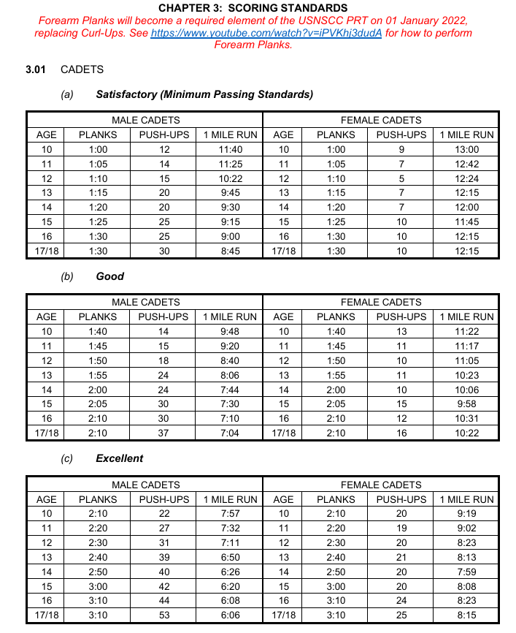

Slide 8


